Slide 1
ICS ’11 in Tucson, Arizona
General Chair:
David K. Lowenthal (Arizona)
PC Co-Chairs:
Bronis R. de Supinski (LLNL)
Sally A. McKee (Chalmers)

Slide 2
Highlights
5 Workshops and 5 Tutorials
Technical program with 35 papers
Poster session with 14 posters
ACM Student Poster Competition
Best paper award
Social events
Poster reception
Pima Air and Space Museum + Banquet

Slide 3
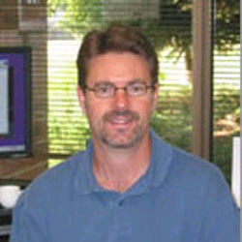
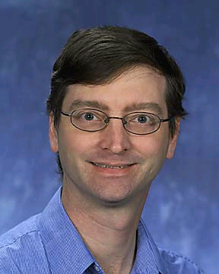
Three Keynotes
Sarita Adve, University of Illinois Urbana-Champaign
Rethinking Shared-Memory Languages and Hardware
Steve Hammond, National Renewable Energy Laboratory
Challenges and Opportunities in Renewable Energy and Energy Efficiency
William D. Gropp, University of Illinois Urbana-Champaign
Performance Modeling as the Key to Extreme Scale Computing

Slide 4
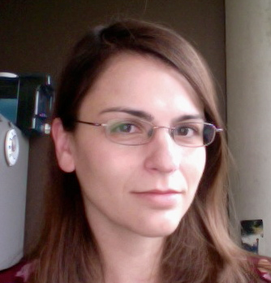
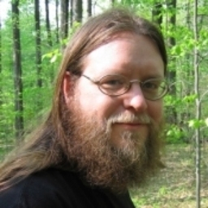
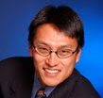
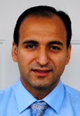
The Organizational Team
Chris Gniady
Conf. Local Arrangements
Boyana Norris
PC Local Arrangements
Xipeng Shen
Workshops/Tutorials
Daniele Scarpazza
Publications
Barry Rountree
Web
Wu Feng
Industry
Vince Freeh
Finance
Daniel Faraj
Registration

Slide 5
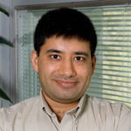
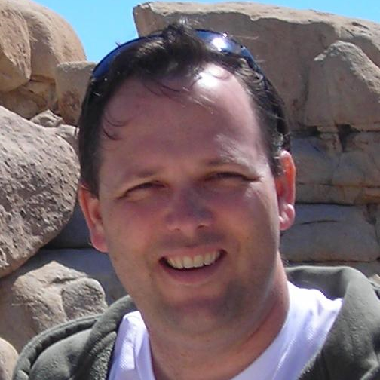
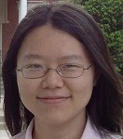
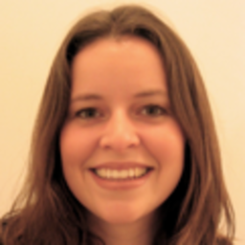
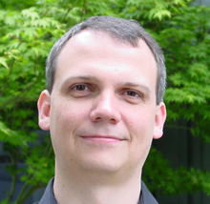
The Organizational Team
Arun Chauhan
Travel Grants
Kirk Cameron
Publicity (US)
Bernd Mohr
Publicity (Europe)
Shan Lu
Posters
Anne Bracy
Posters
Martin Schulz
Vice Chair

Slide 6
Thanks!
Platinum Sponsors:
Gold Sponsors:
Silver Sponsors:

Slide 7
Conference Arrangements
Technical sessions in Salon A and B (for split sessions)
Generally, single sessions before lunch and split sessions after lunch
Poster sessions
ACM Student Poster Competition: today at lunch
Finalists will give talks tomorrow at 1:30PM
General poster session (AMD) today at 7PM
Best paper/poster
Best paper session (Nvidia) today at 10:30AM
Awards presentation Friday morning
Food and Refreshments
Lunch buffet each day in the Flying V (outside, across parking lot)
Breakfast and coffee breaks in foyer outside Salon A

Slide 8
Flying V (Lunch)
Flying V
Lobby

Slide 9
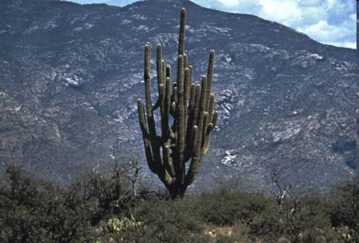
Things to do in Tucson
Museums
Desert Museum
Tucson Museum of Art
Cafes, Restaurants, Pubs
Southwestern Culture
Arts Performances (theater, music, symphony)
Outdoors: Golf, Hiking (many trails), Mt. Lemmon (9,000 feet)
Night Life
Congress Street
Fourth Avenue

Slide 10
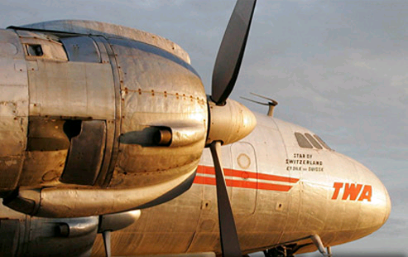
Conference Outing
Pima Air and Space Museum + Banquet
Sponsored by Intel

Slide 11
Program
Outstanding pool of submissions (161)
Accepted 22% (35 papers)
At least four reviews for all papers
Reviews by 70 PC members
Plus over 135 external reviewers
Two stage review process
Rebuttals overlapped with second review phase
Three “Best Paper Finalists” (next session)

Slide 12
Program Committee
PC Meeting
Arrangements by Boyana Norris
Held in Chicago on February 26, 2011
47 attendees, several others by telephone
Discussed all papers with an average of weak accept or above
First round review average determined discussion threshold
Also discussed selected other papers
Finished on time, including best paper candidate selection
Special thanks to ICS11 Web Chair, Barry Rountree, for invaluable support in general and at the PC meeting in particular

Slide 13
Program Committee
Tor Aamodt University of British Columbia Nancy M. Amato Texas A&M University Dorian C. Arnold University of New Mexico Sandro Bartolini Universita degli Studi di Siena Taisuke Boku University of Tsukuba David Brooks Harvard University Alfredo Buttari Institut de Recherche e Informatique de Toulouse
Gregory T. Byrd North Carolina State University John Carter IBM Jacqueline Chame ISI, University of Southern
California Almadena Chtchelkanova National Science Foundation Jaewoong Chung AMD Marcelo Cintra University of Edinburgh Jesus Corbal Intel Luiz De Rose Cray, Inc. James Dehnert Google
Evelyn Duesterwald IBM Alejandro Duran Barcelona Supercomputing Center Rudolf Eigenmann Purdue University
Babak Falsafi Ecole Polytechnique
Federale de Lausanne
Diana Franklin University of California at
Santa Barbara
Todd Gamblin Lawrence Livermore
National Laboratory Ada Gavrilovska Georgia Institute of Technology Roberto Gioiosa Barcelona Supercomputing Center Maya Gokhale Lawrence Livermore
National Laboratory Ganesh Gopalakrishnan University of Utah William D. Gropp University of Illinois at
Urbana-Champaign Mary Hall University of Utah Torsten Hoefler University of Illinois at
Urbana-Champaign Jeffrey K. Hollingsworth University of Maryland Mary Jane Irwin Pennsylvania State University Canturk Isci IBM
Natalie Enright Jerger University of Toronto Lizy John University of Texas at Austin
Russ Joseph Northwestern University

Slide 14
Program Committee
Zhiling Lan Illinois Institute of Technology Benjamin C. Lee Duke University Richard Lethin Reservoir Labs, Inc. and Yale University
Gabriel H. Loh Georgia Institute of Technology
and AMD Sonia Lopez Alarcon Rochester Institute of
Technology Naoya Maruyama Tokyo Institute of Technology Shirley Moore University of Tennessee Tali Moreshet Swarthmore College Matthias S. Mueller Dresden University of
Technology Yang Ni Intel Dimitrios Nikolopoulos FORTH-ICS and
University of Crete Boyana Norris Argonne National Laboratory Daniel Ortega Intel
Padma Raghavan Pennsylvania State University Steven K. Reinhardt AMD Suzanne Rivoire Sonoma State University
Philip C. Roth Oak Ridge National Laboratory Valentina Salapura IBM
Martin Schulz Lawrence Livermore
National Laboratory Kelly A. Shaw University of Richmond Magnus Sjalander Chalmers University of Technology Kevin Skadron University of Virginia Lauren L. Smith US Department of Defense Allan Snavely San Diego Supercomputer Center Karin Strauss Microsoft Research Nathan Tallent Rice University Valerie Taylor Texas A&M University Patricia J. Teller University of Texas at El Paso Rajeev Thakur Argonne National Laboratory
Gary Tyson Florida State University Thomas F. Wenisch University of Michigan Patrick Widener Emory University Qing Yi University of Texas at San Antonio Mohamed Zahran CUNY/NYU Lixin Zhang Institute of Computing Technology,
Beijing

